Slide 1

David M. Kroenke and David J. Auer Database Processing: Fundamentals, Design, and Implementation
Chapter Five:
Data Modeling with the Entity-Relationship Model

Slide 2
Chapter Objectives
To understand the two-phase data modeling/database design process
To understand the purpose of the data modeling process
To understand entity-relationship (E-R) diagrams
To be able to determine entities, attributes, and relationships
To be able to create entity identifiers
To be able to determine minimum and maximum cardinalities

Slide 3
Chapter Objectives
To understand variations of the E-R model
To understand and be able to use ID-dependent and other weak entities
To understand and be able to use supertype/subtype entities
To understand and be able to use strong entity patterns
To understand and be able to use the ID-dependent association pattern
To understand and be able to use the ID-dependent multivalued attribute pattern

Slide 4
Chapter Objectives
To understand and be able to use the ID-dependent archetype/instance pattern
To understand and be able to use the line-item pattern
To understand and be able to use the for-use-by pattern
To understand and be able to use recursive patterns
To understand the iterative nature of the data modeling process
To be able to use the data modeling process

Slide 5
The Data Model
A data model is a plan or blueprint for a database design.
A data model is more generalized and abstract than a database design.
It is easier to change a data model then it is to change a database design, so it is the appropriate place to work through conceptual database problems.

Slide 6
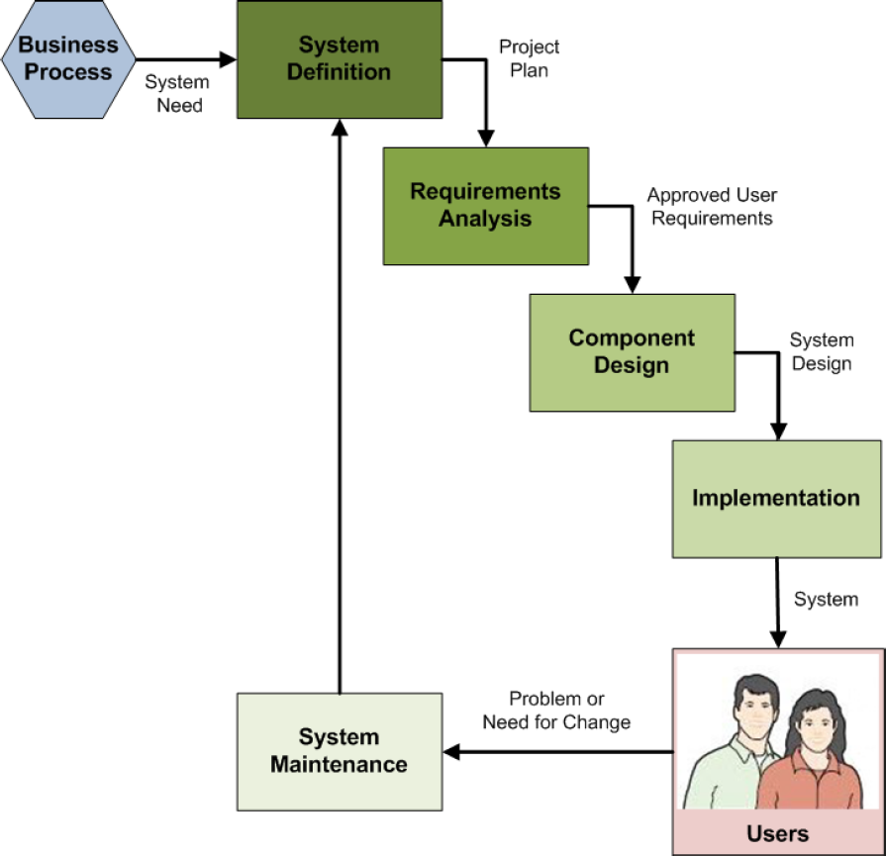
Data Modeling in the SDLC
The Systems development life cycle (SDLC) as discussed in Appendix B
Data modeling occurs in the Requirements Analysis step of the SDLC
The final data model is part of the approved user requirements

Slide 7
Data Model = Conceptual Design
Books on systems analysis and design often identify three design stages:
Conceptual design (conceptual schema)
Logical design (logical schema)
Physical design (physical schema)
The data model we are discussing is equivalent to the conceptual design as defined in these books.

Slide 8
Entity-Relationship (E-R) Model
The Entity-Relationship (E-R) model is a set of concepts and graphical symbols that can be used to create conceptual schemas.
Versions:
Original E-R model—by Peter Chen (1976)
Extended E-R model—extensions to the Chen model
Information Engineering (IE)—by James Martin (1990); uses “crow’s foot” notation, is easier to understand, and we will use it
IDEF1X—a national standard developed by the National Institute of Standards and Technology [see Appendix C]
Unified Modeling Language (UML)—by the Object Management Group; it supports object-oriented methodology [see Appendix D]

Slide 9
Entities
Something that can be identified and the users want to track:
Entity class—a collection of entities of a given type
Entity instance—the occurrence of a particular entity
There are usually many instances of an entity in an entity class.

Slide 10
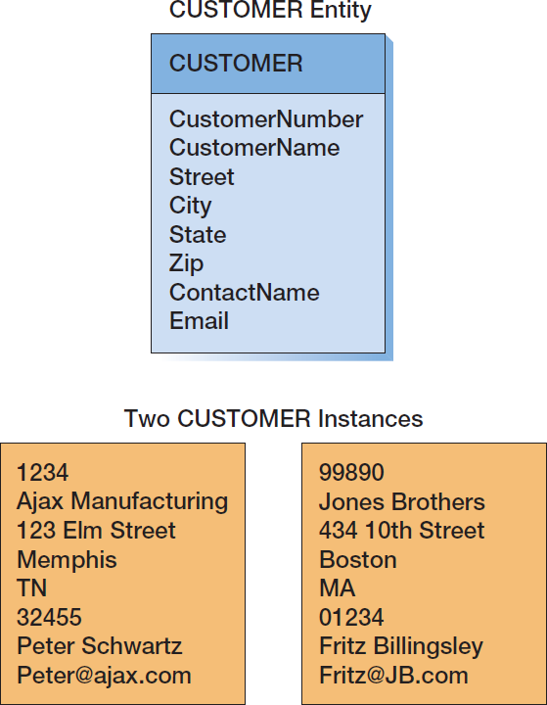
CUSTOMER: The Entity Class and Two Entity Instances

Slide 11
Attributes
Attributes describe an entity’s characteristics.
All entity instances of a given entity class have the same attributes, but vary in the values of those attributes.
Originally shown in data models as ellipses.
Data modeling products today commonly show attributes in rectangular form.

Slide 12
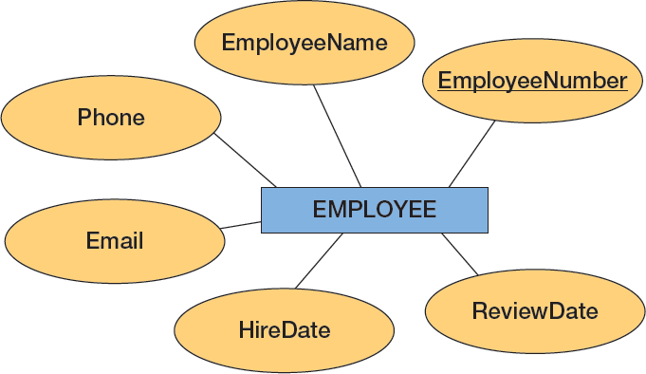
EMPLOYEE: Attributes in Ellipses

Slide 13
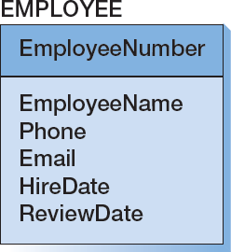
EMPLOYEE: Attributes in Entity Rectangle

Slide 14
Identifiers
Identifiers are attributes that name, or identify, entity instances.
The identifier of an entity instance consists of one or more of the entity’s attributes.
Composite identifiers are identifiers that consist of two or more attributes.
Identifiers in data models become keys in database designs.
Entities have identifiers.
Tables (or relations) have keys.

Slide 15
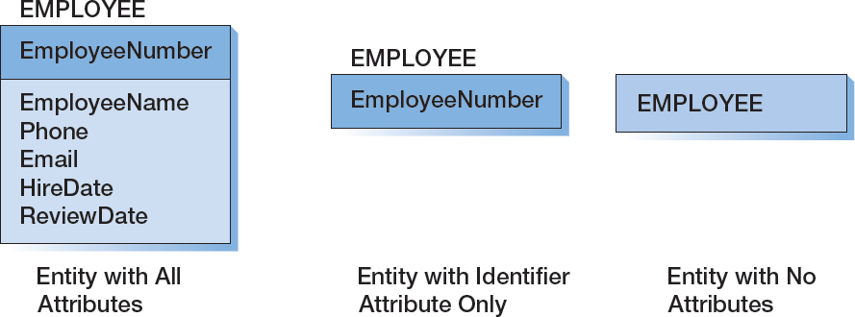
Entity Attribute Display in Data Models

Slide 16
Relationships
Entities can be associated with one another in relationships:
Relationship classes: associations among entity classes
Relationship instances: associations among entity instances
In the original E-R model, relationships could have attributes, but today this is no longer done.
A relationship class can involve two or more entity classes.

Slide 17
Degree of the Relationship
The degree of the relationship is the number of entity classes in the relationship:
Two entities have a binary relationship of degree two.
Three entities have a ternary relationship of degree three.

Slide 18
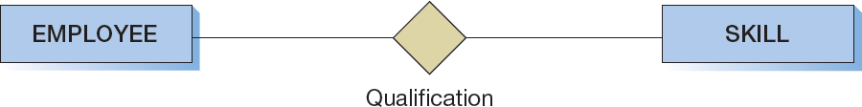
Binary Relationship
Notes:
Some designers believe that it is important to always show the name of a relationship. If so, be aware that you can name a relationship from the perspective of either of the entities or both.
For example, you can name the relationship between DEPARTMENT and EMPLOYEE as Department Consists Of; or you can name it as Employee Works In; or you can name it both ways, using a slash between the two names, Department Consists Of/Employee Works In.
Relationship names are a necessity when there are two different relationships between the same two entities.

Slide 19
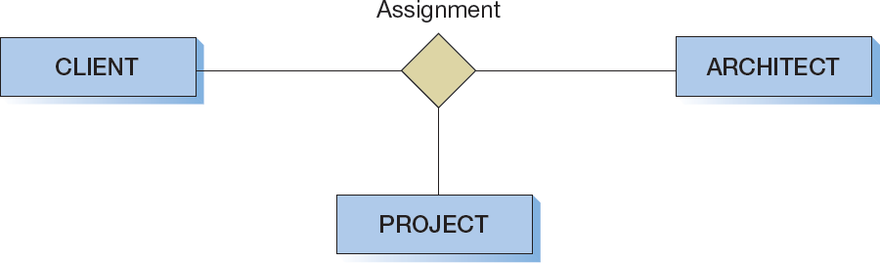
Ternary Relationship

Slide 20
Entities and Tables
The principle difference between an entity and a table (relation) is that you can express a relationship between entities without using foreign keys.
This makes it easier to work with entities in the early design process where the very existence of entities and the relationships between them is uncertain.
Notes:
You can show relationships between entities before you even know what the identifiers are.
For example, you can say that a DEPARTMENT relates to many EMPLOYEEs before you know any of the attributes of either EMPLOYEE or DEPARTMENT.
This characteristic enables you to work from the general to the specific.
First, identify the entities, then think about relationships, and, finally, determine the attributes.

Slide 21
Cardinality
Cardinality means “count,” and is expressed as a number.
Maximum cardinality is the maximum number of entity instances that can participate in a relationship.
Minimum cardinality is the minimum number of entity instances that must participate in a relationship.

Slide 22
Maximum Cardinality
Maximum cardinality is the maximum number of entity instances that can participate in a relationship.
There are three types of maximum cardinality:
One-to-One [1:1]
One-to-Many [1:N]
Many-to-Many [N:M]

Slide 23
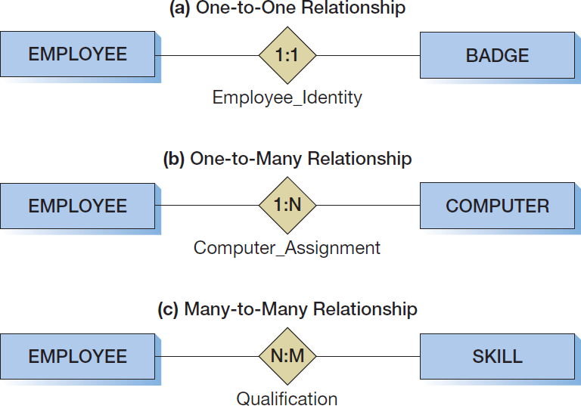
The Three Types of Maximum Cardinality

Slide 24
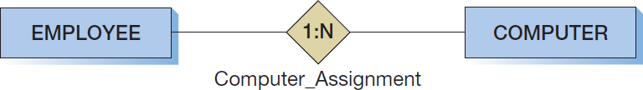
Parent and Child Entities
In a one-to-many relationship:
The entity on the one side of the relationship is called the parent entity or just the parent.
The entity on the many side of the relationship is called the child entity or just the child.
In the figure below, EMPLOYEE is the parent and COMPUTER is the child:

Slide 25
HAS-A Relationships
The relationships we have been discussing are known as HAS-A relationships:
Each entity instance has a relationship with another entity instance.
An EMPLOYEE has one or more COMPUTERs.
A COMPUTER has one assigned EMPLOYEE.

Slide 26
Minimum Cardinality
Minimum cardinality is the minimum number of entity instances that must participate in a relationship.
Minimums are generally stated as either zero or one:
IF zero [0] THEN participation in the relationship by the entity is optional, and no entity instance must participate in the relationship.
IF one [1] THEN participation in the relationship by the entity is mandatory, and at least one entity instance must participate in the relationship.

Slide 27
Indicating Minimum Cardinality
As shown in the examples in a following slide:
Minimum cardinality of zero [0] indicating optional participation is indicated by placing an oval next to the optional entity.
Minimum cardinality of one [1] indicating mandatory (required) participation is indicated by placing a vertical hash mark next to the required entity.

Slide 28
Reading Minimum Cardinality
Look toward the entity in question:
IF you see an oval THEN that entity is optional (minimum cardinality of zero [0]).
IF you see a vertical hash mark THEN that entity is mandatory (required) (minimum cardinality of one [ 1]).

Slide 29
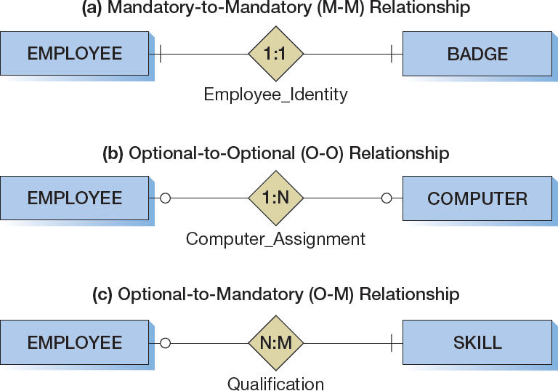
The Three Types of Minimum Cardinality
Notes:
Sometimes when interpreting diagrams like the ones in this slide students become confused about which entity is optional and which is required.
An easy way to clarify this situation is to imagine that you are standing in the diamond on the relationship line.
Imagine looking toward one of the entities. If you see an oval in that direction, then that entity is optional; if you see a hash mark, then that entity is required.
Thus, in (c), if you stand on the diamond and look toward SKILL, you see a hash mark. This means that SKILL is required in the relationship. If you then turn around and look toward EMPLOYEE, you see a circle. This means that EMPLOYEE is optional in the relationship.

Slide 30
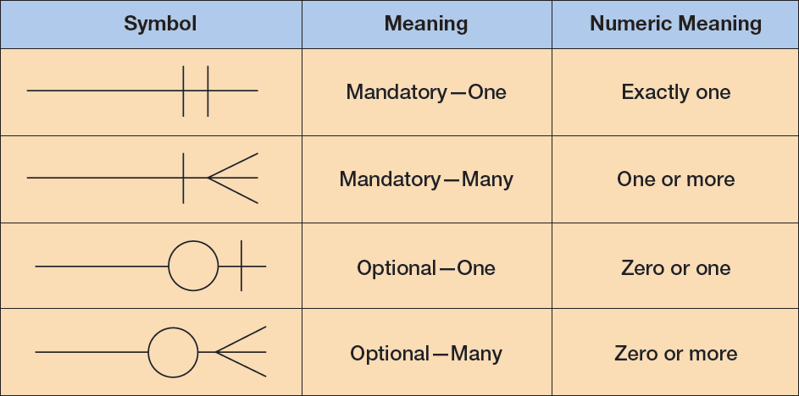
Data Modeling Notation: IE Crow’s Foot
Notes:
A number of modeling products are available, and each will have its own idiosyncrasies.
CA Technologies produces ERwin, a commercial data modeling product that handles both data modeling and database design tasks. You can download the CA ERwin Data Modeler Community Edition, which is suitable for class use, from CA. You can use ERwin to produce either crow’s foot or IDEF1X data models.
You can also try ER-Assistant, which is free and downloadable from Software
Informer.
Microsoft Visio 2013 is also a possibility. A trial version is available from the Microsoft Web site. See Appendix F for a full discussion of using Microsoft Visio 2013 for data models.
Finally, Oracle is continuing development of the MySQL Workbench, as described in this book in Chapters 2 and 10C, and a free (but somewhat limited) version is available at the MySQL development Web site. (If you are using a Microsoft operating system, you should install the MySQL Workbench by downloading and running the MySQL Installer for Windows). Although it is better at database designs than data models, it is a very useful tool, and the database designs it produces can be used with any DBMS, not just MySQL. See Appendix E for a full discussion of using MySQL Workbench for database designs.

Slide 31
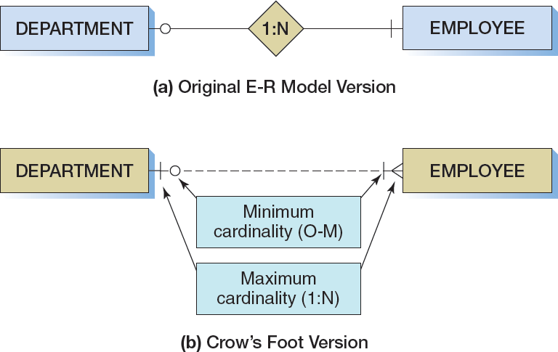
Data Modeling Notation: IE Crow’s Foot 1:N

Slide 32
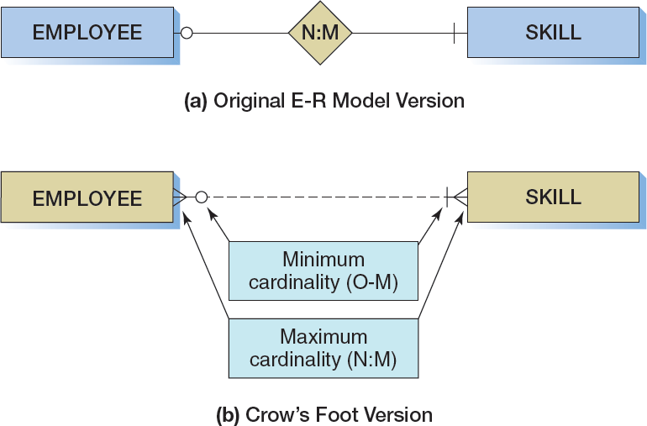
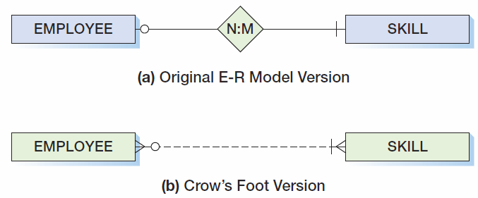
Data Modeling Notation: IE Crow’s Foot N:M

Slide 33
ID-Dependent Entities
An ID-dependent entity is an entity (child) whose identifier includes the identifier of another entity (parent).
The ID-dependent entity is a logical extension or subunit of the parent:
BUILDING : APARTMENT
PAINTING : PRINT
The minimum cardinality from the ID-dependent entity to the parent is always one.

Slide 34
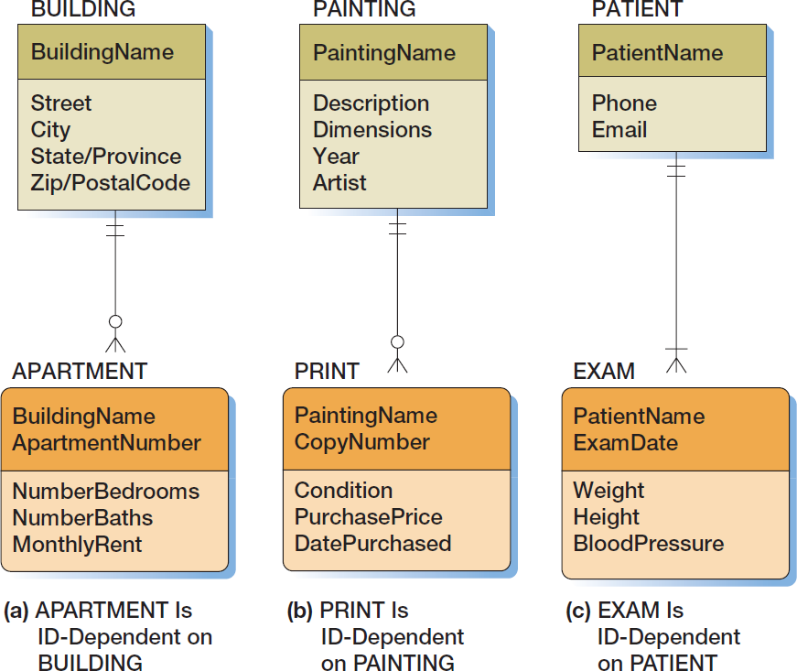
ID-Dependent Entities
Notes:
The parent entity of a child ID-dependent entity is sometimes referred to as an owner entity.
For example, a BUILDING is the owner of the APARTMENTs within it.

Slide 35
Weak Entities
A weak entity is an entity whose existence depends upon another entity.
All ID-Dependent entities are considered weak.
There are also non-ID-dependent weak entities.
The identifier of the parent does not appear in the identifier of the weak child entity.

Slide 36
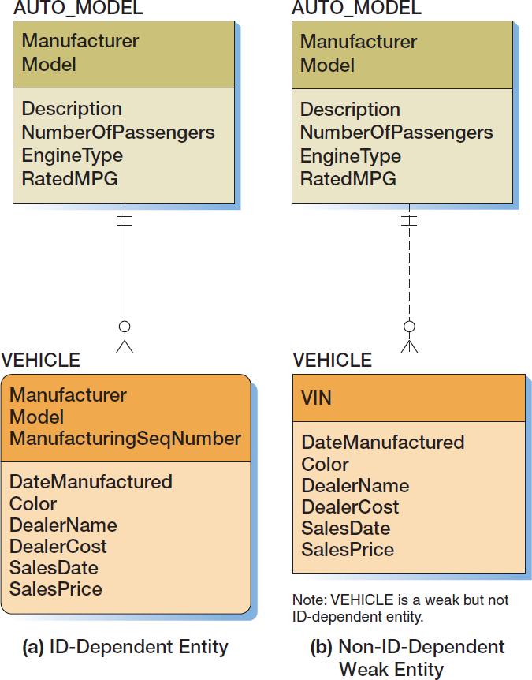
Weak Entities

Slide 37
Identifying Relationships
The solid line connecting an ID-dependent entity and its parent is called an identifying relationship.
The dashed line connecting strong entities or a non-ID-dependent weak entity to its parent is called a nonidentifying relationship.

Slide 38
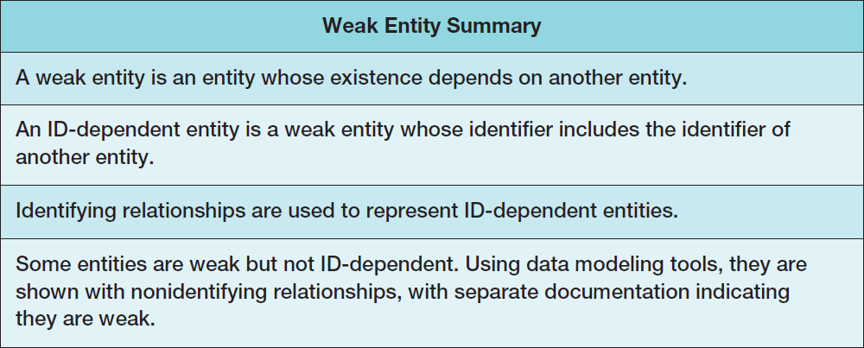
ID-Dependent and Weak Entities
Notes:
Unfortunately, an ambiguity is hidden in the definition of a weak entity, and this ambiguity is interpreted differently by different database designers (as well as different textbook authors).
The ambiguity is that in a strict sense, if a weak entity is defined as any entity whose presence in the database depends on another entity, then any entity that participates in a relationship having a minimum cardinality of one to a second entity is a weak entity. Thus, in an academic database, if a STUDENT must have an ADVISER, then STUDENT is a weak entity because a STUDENT entity cannot be stored without an ADVISER.
This interpretation seems too broad to some people. A STUDENT is not physically dependent on an ADVISER (unlike an APARTMENT to a BUILDING), and a STUDENT is not logically dependent on an ADVISER (despite how it might appear to either the student or the adviser), and, therefore, STUDENT should be considered a strong entity.
To avoid such situations, some people interpret the definition of weak entity more narrowly. They say that to be a weak entity an entity must logically depend on another entity. According to this definition, APARTMENT is a weak entity, but STUDENT is not. An APARTMENT cannot exist without a BUILDING in which it is located. However, a STUDENT can logically exist without an ADVISER, even if a business rule requires it.
We agree with the latter approach. Characteristics of ID-dependent and non-ID-dependent weak entities, as used in this book, are summarized here.

Slide 39
Subtype Entities
A subtype entity is a special case of a supertype entity:
STUDENT : UNDERGRADATE or GRADUATE
The supertype contains all common attributes, while the subtypes contain specific attributes.
The supertype may have a discriminator attribute which indicates the subtype.

Slide 40
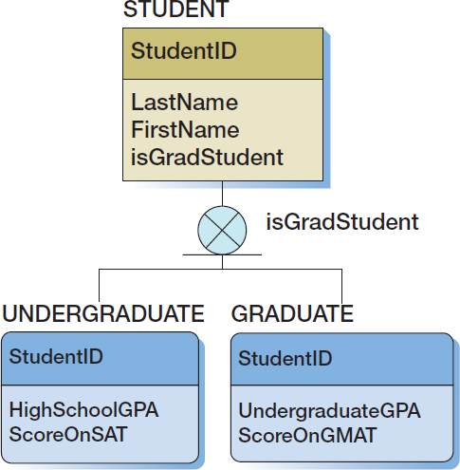
Subtypes with Discriminators

Slide 41
Subtypes: Exclusive or Inclusive
If subtypes are exclusive, one supertype relates to at most one subtype.
If subtypes are inclusive, one supertype can relate to one or more subtypes.

Slide 42
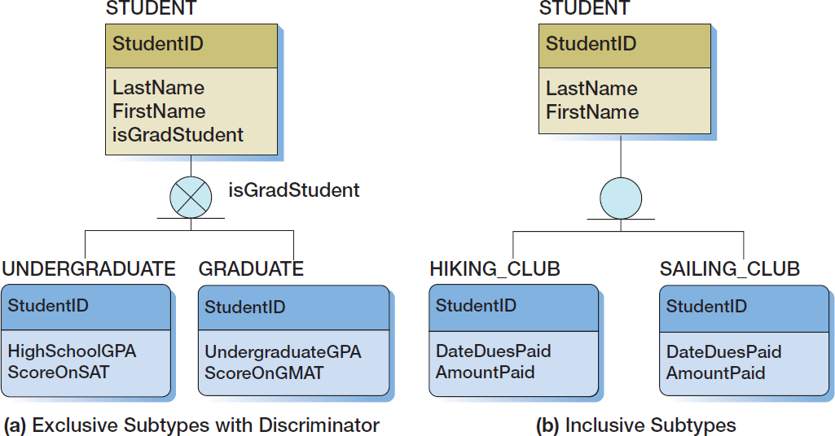
Subtypes: Exclusive or Inclusive

Slide 43
Subtypes: Partial or Total
If a supertype has to be in one of the subtypes, then the subtypes are total subtypes.
If a supertype does not have to be in any of the subtypes, then the subtypes are partial subtypes.

Slide 44
Subtypes: IS-A Relationships
Relationships connecting supertypes and subtypes are called IS-A relationships, because a subtype is a supertype.
The identifier of the supertype and all of its subtypes must be identical; i.e., the identifier of the supertype becomes the identifier of the related subtype(s).
Subtypes are used to avoid value-inappropriate nulls.

Slide 45
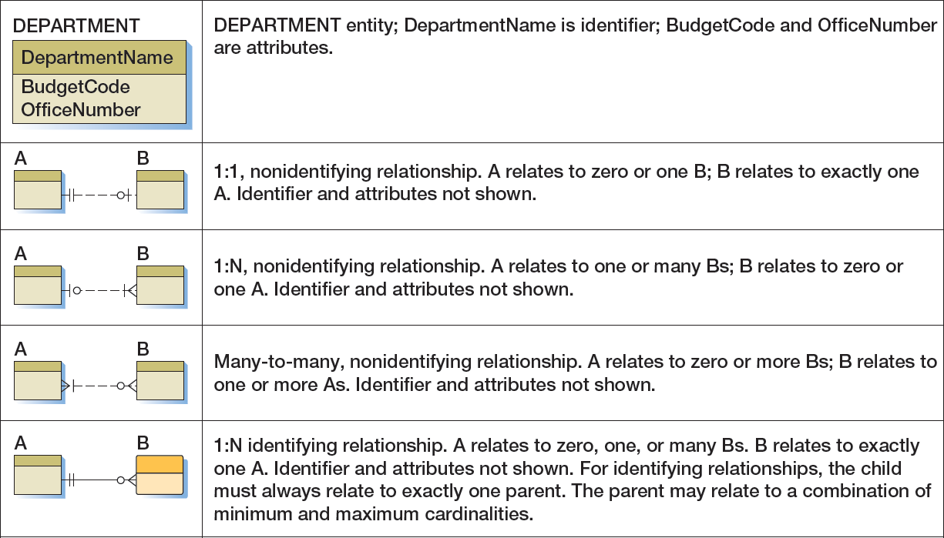
IE Crow’s Foot Symbol Summary I

Slide 46
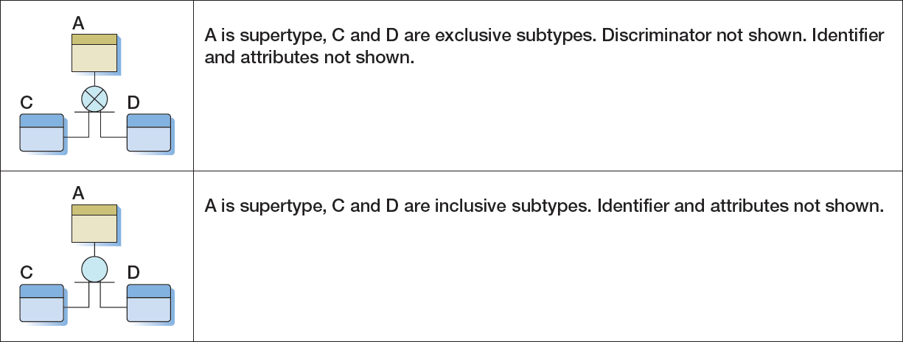
IE Crow’s Foot Symbol Summary II

Slide 47
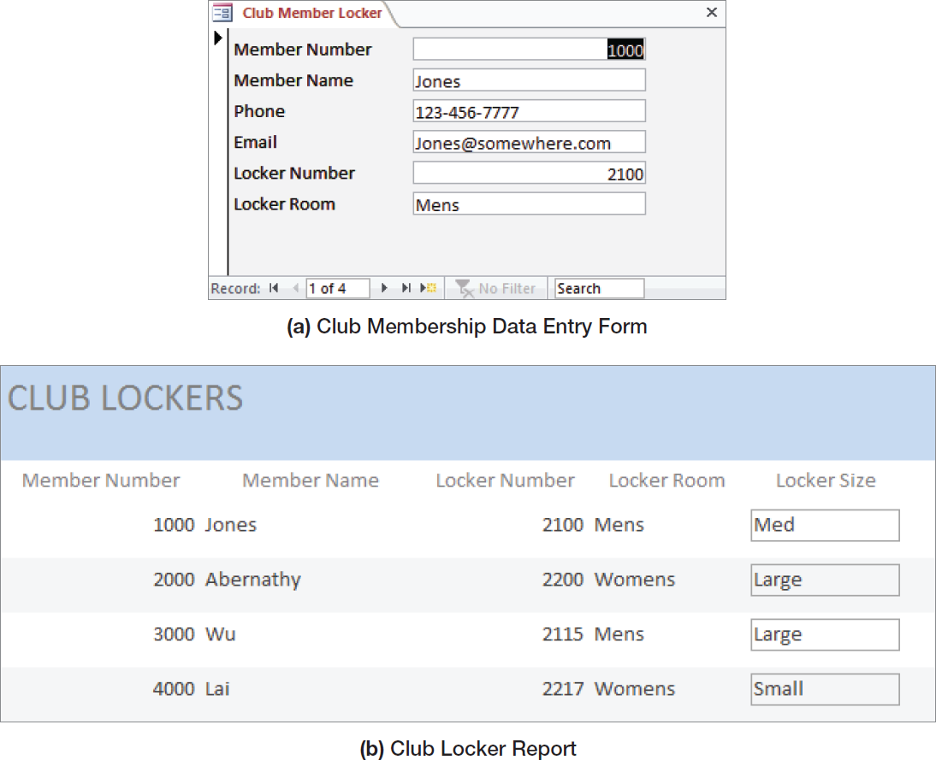
Strong Entity Patterns: 1:1 Strong Entity Relationships I

Slide 48
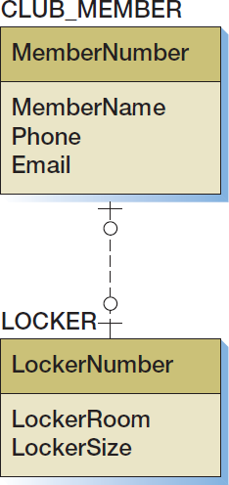
Strong Entity Patterns: 1:1 Strong Entity Relationships II
Notes:
How do you recognize strong entities? You can use two major tests. First, does the entity have an identifier of its own? If it shares a part of its identifier with another entity, then it is an ID-dependent entity and is therefore weak.
Second, does the entity seem to be logically different from and separate from the other entities? Does it stand alone, or is it part of something else?
In this case, a CLUB_MEMBER and a LOCKER are two very different, separate things; they are not part of each other or of something else.
Hence, they are strong.
Note also that a form or report shows only one side of a relationship. Given entities A and B, a form can show the relationship from A to B, but it cannot show the relationship from B to A at the same time.
To learn the cardinality from B to A, you must examine a second form or report, ask the users, or take some other action.
Finally, it is seldom possible to infer minimum cardinality from a form or report. Generally, you must ask the users.

Slide 49
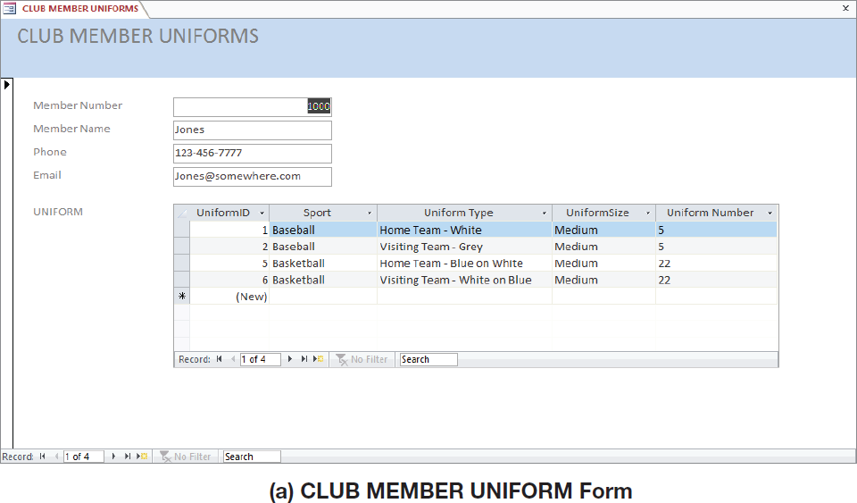
Strong Entity Patterns: 1:N Strong Entity Relationships I

Slide 50
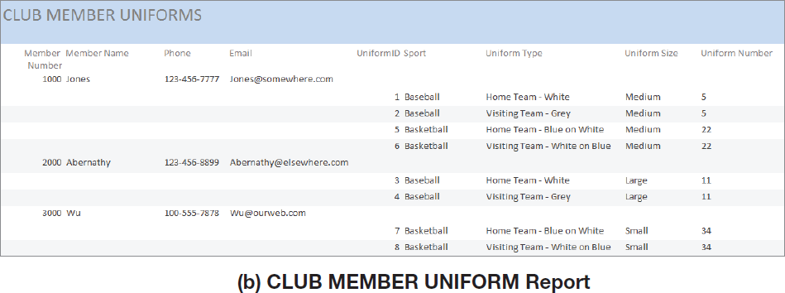
Strong Entity Patterns: 1:N Strong Entity Relationships II

Slide 51
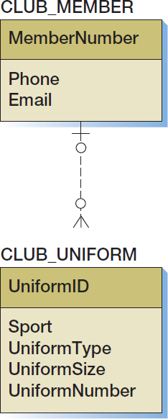
Strong Entity Patterns: 1:N Strong Entity Relationships III

Slide 52
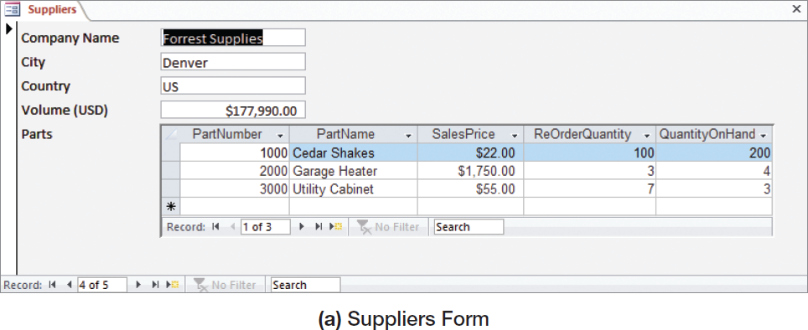
Strong Entity Patterns: N:M Strong Entity Relationships I

Slide 53
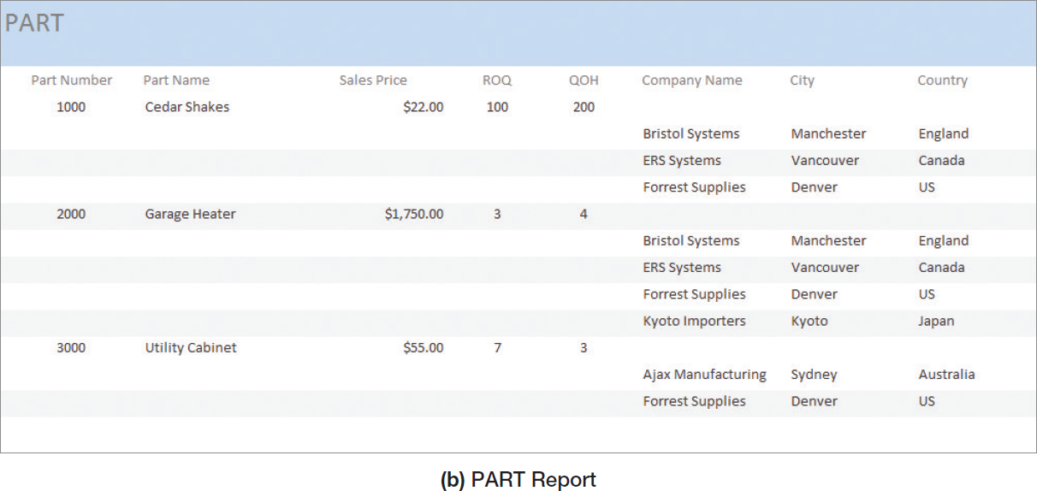
Strong Entity Patterns: N:M Strong Entity Relationships II

Slide 54
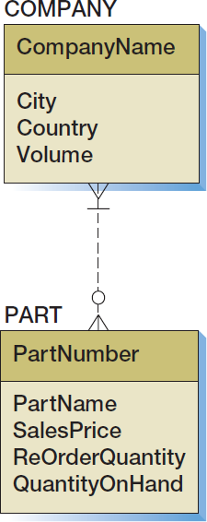
Strong Entity Patterns: N:M Strong Entity Relationships III

Slide 55
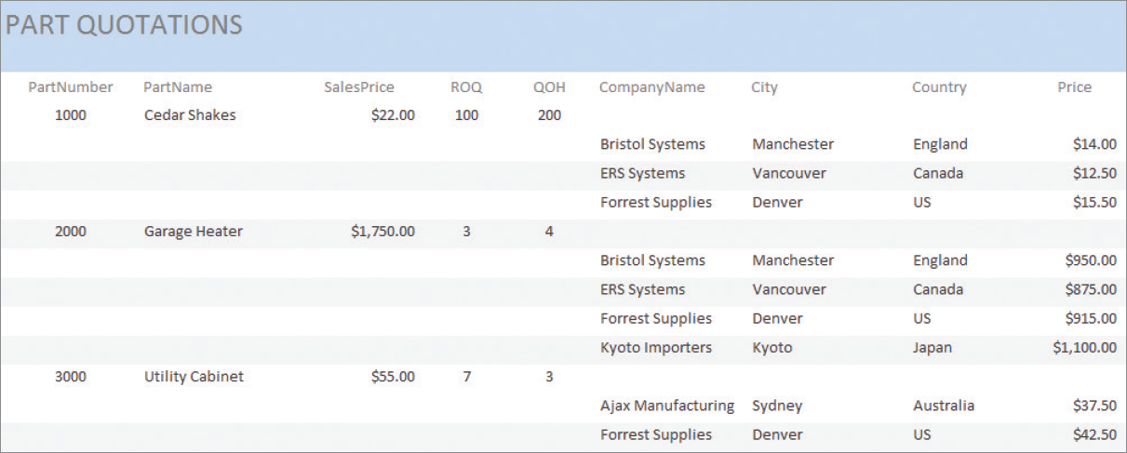
ID-Dependent Relationships: The Association Pattern I

Slide 56
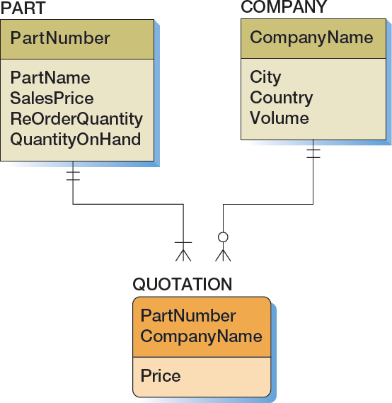
ID-Dependent Relationships: The Association Pattern II
PartNumber and CompanyName are the identifiers of the parent entities, and are needed because QUOTATION is ID-dependent on both PART and COMPANY
An entity that holds one or more additional attributes beyond the identifiers of the parent entities is called an associative entity (or association entity)─in this case Price is the additional attribute

Slide 57
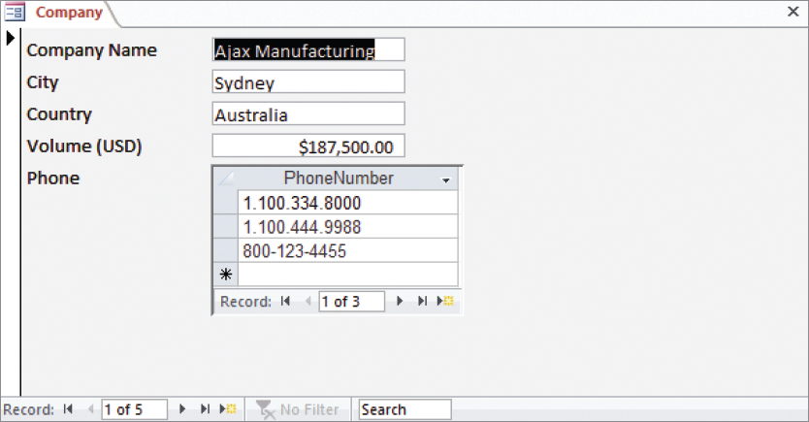
ID-Dependent Relationships: The Multivalued Attribute Pattern I

Slide 58
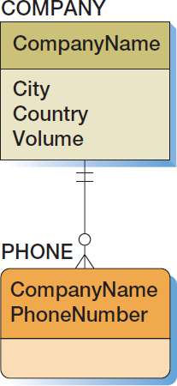
ID-Dependent Relationships: The Multivalued Attribute Pattern II

Slide 59
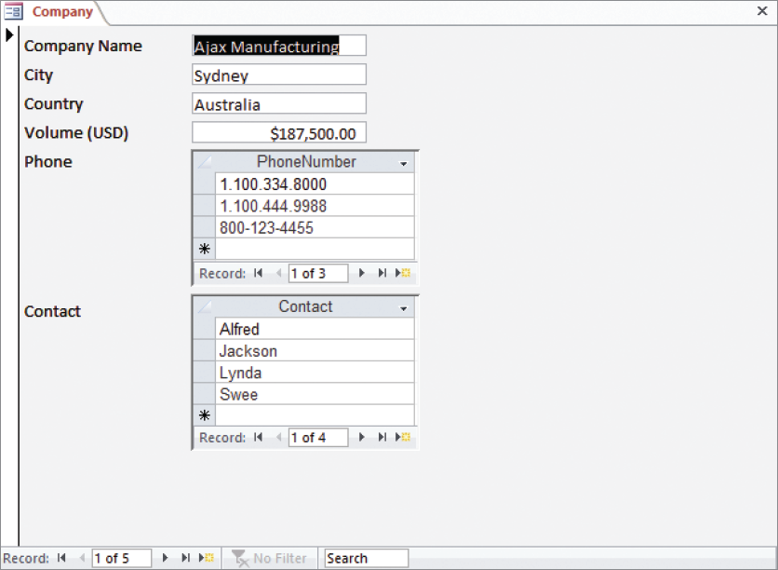
ID-Dependent Relationships: The Multivalued Attribute Pattern III

Slide 60
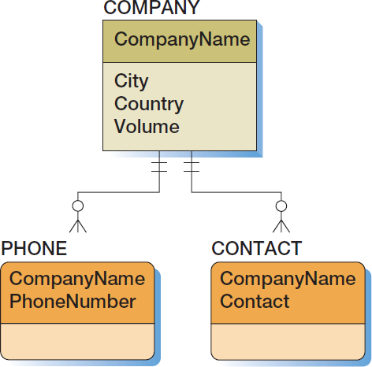
ID-Dependent Relationships: The Multivalued Attribute Pattern IV

Slide 61
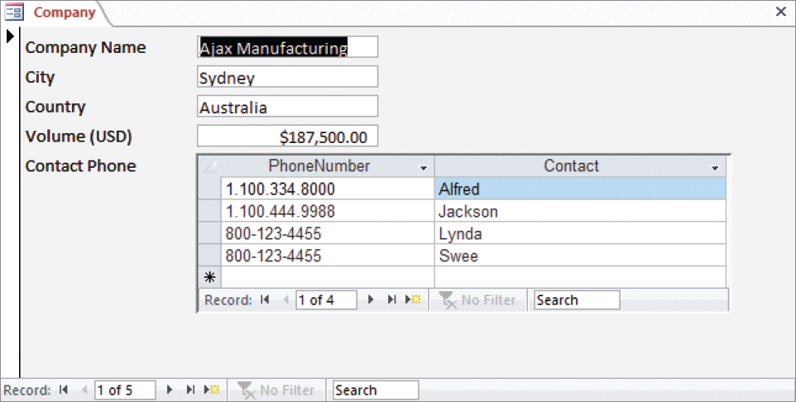
ID-Dependent Relationships: Composite Multivalued Attributes I

Slide 62
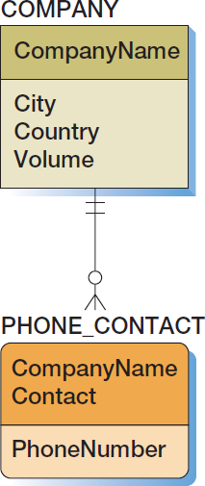
ID-Dependent Relationships: Composite Multivalued Attributes II

Slide 63
ID-Dependent Relationships: The Archetype/Instance Pattern I
The archetype/instance pattern occurs when the ID-dependent child entity is the physical manifestation (instance) of an abstract or logical parent.
PAINTING : PRINT
CLASS : SECTION
YACHT_DESIGN : YACHT
HOUSE_MODEL: HOUSE

Slide 64
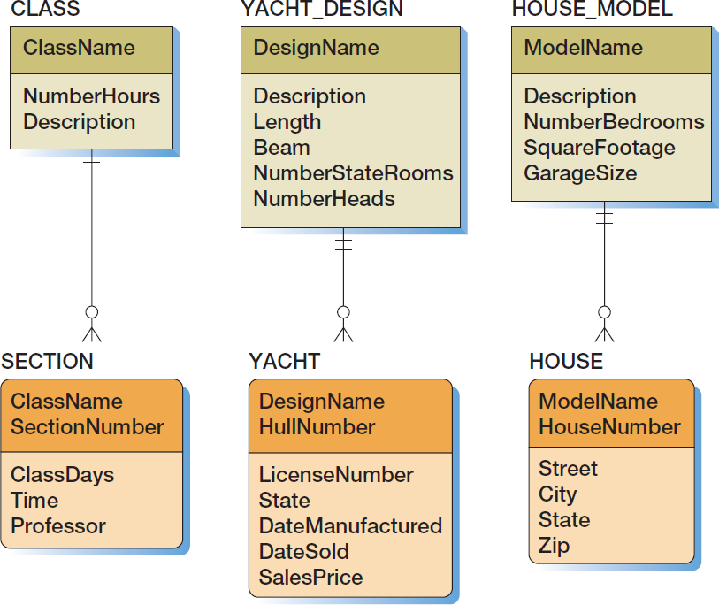
ID-Dependent Relationships: The Archetype/Instance Pattern II

Slide 65
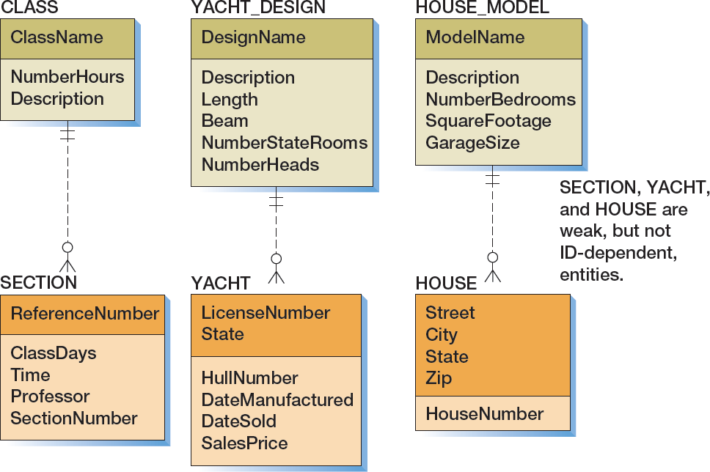
ID-Dependent Relationships: The Archetype/Instance Pattern III
Notes:
Data modelers continue to debate the importance of weak, non-ID-dependent entities. Everyone agrees that they exist, but not everyone agrees that they are important.
First, understand that existence dependence influences the way we write database applications. For the CLASS/SECTION example in this slide, we must insert a new CLASS before we can add a SECTION for that class. Additionally, when we delete a CLASS, we must delete all of the SECTIONs for that CLASS as well. This is one reason that some data modelers believe that weak, non-ID-dependent entities are important.
Skeptics say that although weak, non-ID-dependent entities may exist, they are not necessary. They say that we can obtain the same result by calling SECTION strong and making CLASS required. Because CLASS is required, the application will need to insert a CLASS before a SECTION is created and delete dependent SECTIONs when deleting a CLASS. So, according to that viewpoint, there is no practical difference between a weak, non-ID-dependent entity and a strong entity with a required relationship.
Others disagree. Their argument goes something like this: The requirement that a SECTION must have a CLASS comes from a logical necessity. It has to be that way—it comes from the nature of reality. The requirement that a strong entity must have a relationship to another strong entity arises from a business rule. Initially, we say that an ORDER must have a CUSTOMER (both strong entities), and then the application requirements change and we say that we can have cash sales, meaning that an ORDER no longer has to have a CUSTOMER. Business rules frequently change, but logical necessity never changes. We need to model weak, non-ID-dependent entities so that we know the strength of the required parent rule.

Slide 66
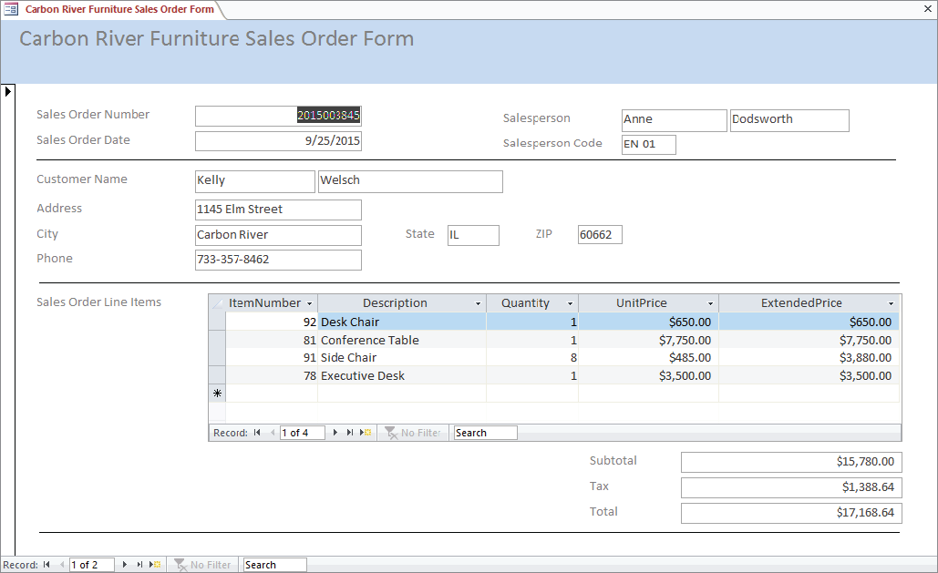
Mixed Patterns: The Line-Item Pattern I

Slide 67
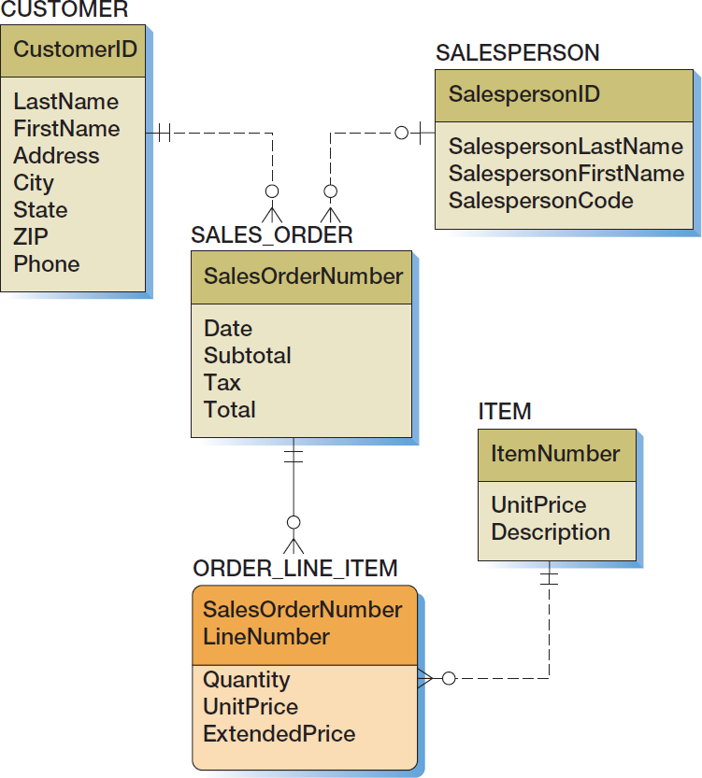
Mixed Patterns: The Line-Item Pattern II

Slide 68
Mixed Patterns: Other Mixed Patterns I
Look for a mixed pattern where:
A strong entity has a multivalued composite group
One of the elements of the composite group is an identifier of another strong entity.

Slide 69
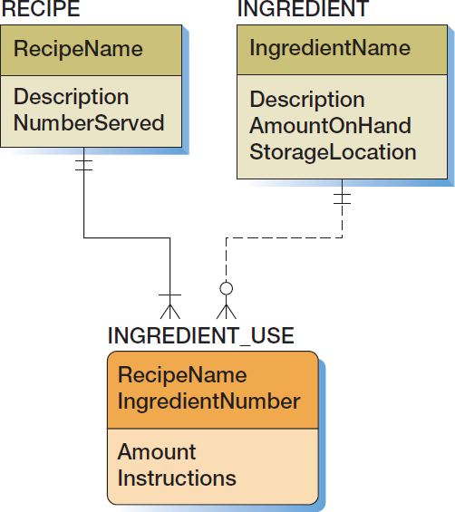
Mixed Patterns: Other Mixed Patterns II
IngredientName (which will be added to INGREDIENT_USE as a foreign key in Chapter 6) is the identifier of a strong entity
INGREDIENT_USE is a multivalued composite group holding the ingredient list data
Amount and Instructions are ID-dependent on RECIPE

Slide 70
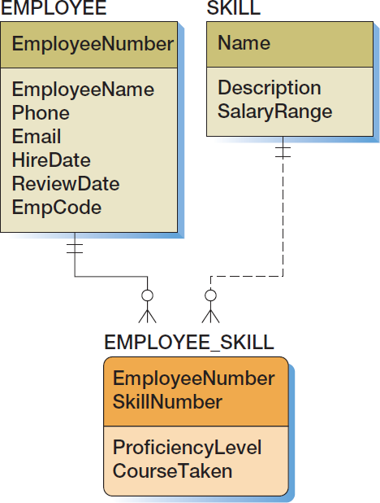
Mixed Patterns: Other Mixed Patterns III
Name (which will be added to EMPLOYEE_SKILL as a foreign key in Chapter 6) is the identifier of a strong entity
EMPLYEE_SKILL is a multivalued composite group holding the list of skills for each employee
ProficiencyLevel and CourseTaken are ID-dependent on EMPLOYEE

Slide 71
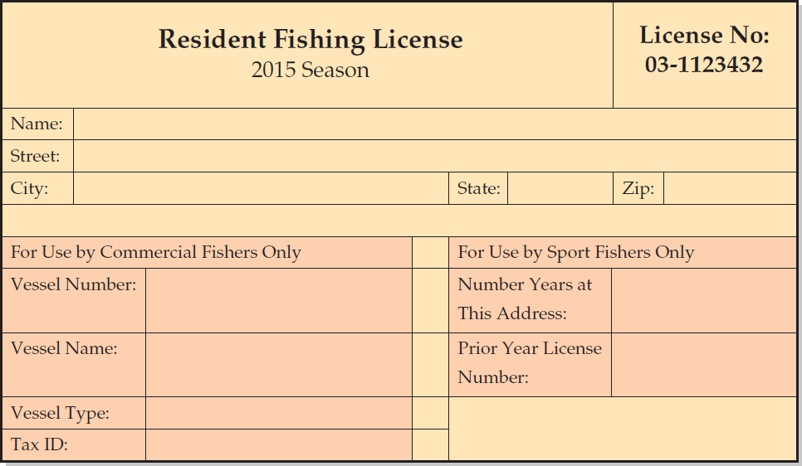
Mixed Patterns: The For-Use-By Pattern I

Slide 72
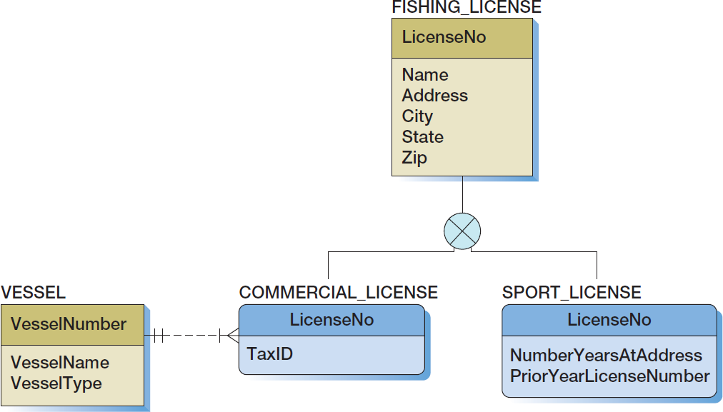
Mixed Patterns: The For-Use-By Pattern II

Slide 73
Recursive Relationships
A recursive relationship occurs when an entity has a relationship to itself.

Slide 74
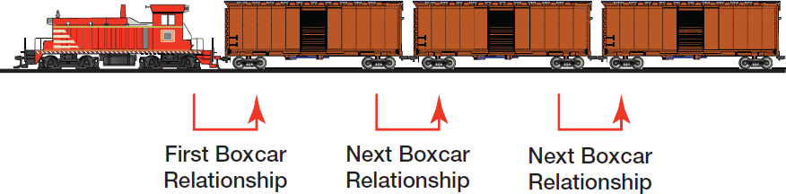
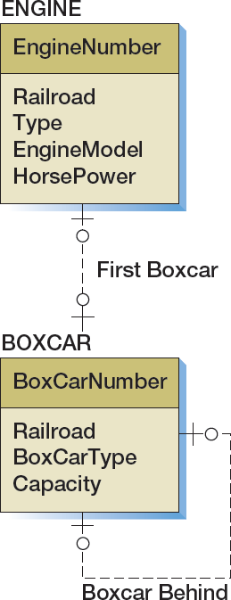
Recursive Patterns: 1:1 Recursive Relationship
Notes:
Note that the 1:1 relationship between the ENGINE entity and the BOXCAR entity is optional—optional (O-O). This is because the BOXCAR entity represents all the BOXCARs in the train.
While the first BOXCAR must be connected directly to the ENGINE, the second BOXCAR is not connected to the engine. Therefore, the relationship from ENGINE to BOXCAR is optional because the ENGINE does not have to be directly connected to each BOXCAR, and the relationship from BOXCAR to ENGINE is optional because each BOXCAR does not have to be connected to the ENGINE.
Also note that several years ago we would have also needed a CABOOSE entity to bring up the rear of the train. Today, railroads are permitted to use an end-of-train marker light on the last freight car, and there are few cabooses to be seen.
An alternative model is to use the relationship to represent the BOXCAR ahead. Either model works.
Other examples of 1:1 recursive relationships are the succession of U.S. presidents, the succession of deans in a college of business, and the order of passengers on a waiting list.

Slide 75
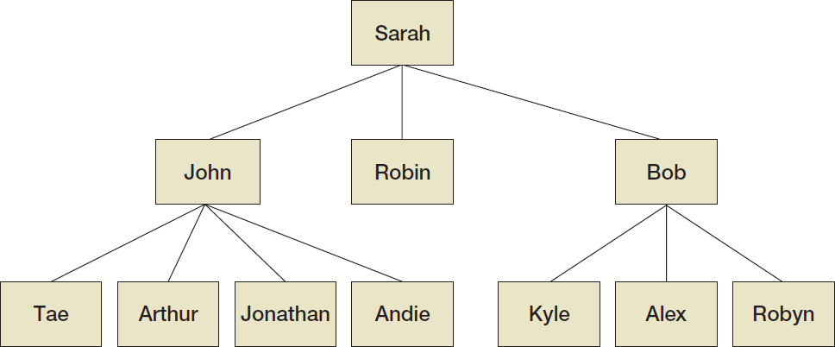
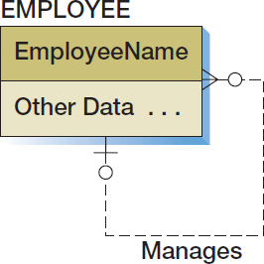
Recursive Patterns: 1:N Recursive Relationship

Slide 76
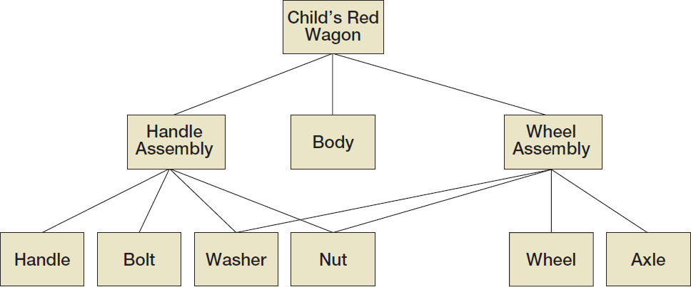

Recursive Patterns: N:M Recursive Relationship III
Notes:
What would happen to the data model if the diagram showed how many of each part are used? Suppose, for example, that the wheel assembly requires four washers and the handle assembly requires just one.
This data model will not be correct for this circumstance. In fact, adding Quantity to this N:M relationship is analogous to adding Price to an N:M relationship.
See Project Question 5.63

Slide 77
Highline University Creating a Data Model
Suppose the administration at a hypothetical university named Highline University wants to create a database to track colleges, departments, faculty, and students.
To do this, a data modeling team has collected a series of reports as part of its requirements determination.

Slide 78

Highline University The College Report

Slide 79

Highline University First Data Model

Slide 80

Highline University The Department Report

Slide 81

Highline University Second Data Model I

Slide 82

Highline University Second Data Model II

Slide 83

Highline University Second Data Model III

Slide 84

Highline University Second Data Model IV

Slide 85

Highline University The Department Student Report

Slide 86

Highline University Third Data Model

Slide 87

Highline University Sample Student Acceptance Letter

Slide 88

Highline University Fourth Data Model

Slide 89

Highline University Final Data Model

Slide 90
David Kroenke and David Auer Database Processing Fundamentals, Design, and Implementation (14th Edition)
End of Presentation:
Chapter Five

Slide 91

All rights reserved. No part of this publication may be reproduced, stored in a retrieval system, or transmitted, in any form or by any means, electronic, mechanical, photocopying, recording, or otherwise, without the prior written permission of the publisher. Printed in the United States of America.

